Slide 1
TITLE
RESEARCH ABOUT FILM INDUSTRY
FOR MICROSOFT CORPORATION

Slide 2
INTRODUCTION
This is a research for Microsoft about film industry as they want to venture into the new market they know nothing of
This research is going to help us get insighs about the market trends and other factors used

Slide 3
Business understanding
Revenue streams- this can include revenue generated from ticket sales in cinemas and other platforms
Value chain – what is comprised here is production of films, distribution and marketing.
Market trends- film industry is diverse and wide, sticking to one category can throw you out of the business.
Key players in the industry- these are companies who invested earlier on filming
Marketing and promotions – ways on how to promote our product in the market to get return on investment
Challenges- challenging matters about this industry

Slide 4
Data understanding
Interact with data and generate insights from the data
unravel the relationship and underlying trends and patterns within the industry’s data landscape.
We seek to know and understand key factors that influence other studios performance in the market, the impact of different genres on films success and the changing

Slide 5
Data sources
We have assembled data from past records about film franchise
Data has also been collected from movie websites like rotten tomato, The numbers, The Box Office Mojo and from the IMDB database

Slide 6
analysis
1. Average rating relationship with runtime
Movies that mostly get rated by viewers are movies with a runtime of close to 90 minutes. From with we can depict that most audience love movies running for one and half hours. This relates that we should produce movies with such duration during the launch of our first production
Also from the scatter plot we can see movies with 60 min to 70 minutes is rarely low rated by the audience. We have few counts of rating where average rating is 0 to 5 but count of rating increases where average rating values are 5.5 to 9. We can

Slide 7
1.2Vote count relationship with popularity
From vote and popularity we can see that movies with vote counts of less that 5000 are the most popular and have a popularity ranging from 0 to 30. From There we see a negative correlation relationship between the two.
While vote count inreases the popularity decreases,

Slide 8
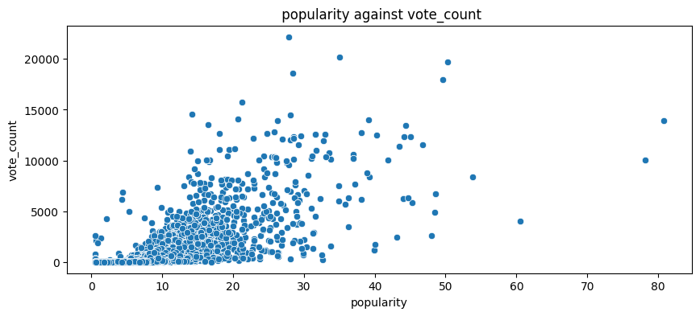
Genre relationship with viewer rating

Slide 9
3. Runtime relationship VIEWER RATING
From the analysis we can see that movies with NC 17 has a runtime of 90 min, G is kind of scattered but we can see it averages 75 to 100 min, the PG13 and PG movies are almost similar and have a runtime starting from 80 min to 140 min.
NR has runtime starting from 60 to 140 taking the most runtime range from the different viewer ratings.
Not R is similar to PG13 and PG as it has a runtime starting from 80 min to 140 min.
From the above data we can know which rating to associate with what runtime.

Slide 10
